Slide 1
INTRODUCTION AND HISTORY OF JAVA

Slide 2
What is Java
Java is a high-level, class-based, object-oriented programming language that is
designed to have as few implementation dependencies as possible.
It is a general-purpose programming language intended to let programmers write once
, run anywhere (WORA),] meaning that compiled Java code can run on all platforms
that support Java without the need to recompile.
Java applications are typically compiled to bytecode that can run on any Java virtual
machine (JVM) regardless of the underlying computer architecture.
The syntax of Java is similar to C and C++, but has fewer low-level facilities than either
of them.
The Java runtime provides dynamic capabilities (such as reflection and runtime code
modification) that are typically not available in traditional compiled languages.

Slide 3
History of Java
The history of Java is very interesting.
Java was originally designed for interactive television, but it was too advanced
technology for the digital cable television industry at the time.
The history of Java starts with the Green Team. Java team members (also known
as Green Team), initiated this project to develop a language for digital devices such
as set-top boxes, televisions, etc
However, it was best suited for internet programming. Later, Java technology was
incorporated by Netscape.
The principles for creating Java programming were "Simple, Robust, Portable
Platform-independent, Secured, High Performance, Multithreaded, Architecture
Neutral, Object-Oriented, Interpreted, and Dynamic".
Java was developed by James Gosling, who is known as the father of Java, in
1995. James Gosling and his team members started the project in the early '90s.

Slide 4
Currently, Java is used in internet programming, mobile devices, games, e-business solutions, etc. Following are given significant points that describe the history of Java.
2:27
+
Loaded: 56.78%
Â
Loaded: 56.78%
Â
1) James Gosling, Mike Sheridan, and Patrick Naughton initiated the Java language project in June 1991. The small team of sun engineers called Green Team.
2) Initially it was designed for small, embedded systems in electronic appliances like set-top boxes.
3) Firstly, it was called "Greentalk" by James Gosling, and the file extension was .gt.
4) After that, it was called Oak and was developed as a part of the Green project.

Slide 5
Why Java Programming named "Java"?
In 1995, Oak was renamed as "Java" because it was already a trademark by Oak Technologies.
Why had they chose the name Java for Java language? The team gathered to choose a new name. The suggested words were "dynamic", "revolutionary", "Silk", "jolt", "DNA", etc. They wanted something that reflected the essence of the technology: revolutionary, dynamic, lively, cool, unique, and easy to spell, and fun to say.
According to James Gosling, "Java was one of the top choices along with Silk". Since Java was so unique, most of the team members preferred Java than other names.
8) Java is an island in Indonesia where the first coffee was produced (called Java coffee). It is a kind of espresso bean. Java name was chosen by James Gosling while having a cup of coffee nearby his office.

Slide 6
) Notice that Java is just a name, not an acronym.
10) Initially developed by James Gosling at Sun Microsystems (which is now a subsidiary of Oracle Corporation) and released in 1995.
11) In 1995, Time magazine called Java one of the Ten Best Products of 1995.
12) JDK 1.0 was released on January 23, 1996. After the first release of Java, there have been many additional features added to the language. Now Java is being used in Windows applications, Web applications, enterprise applications, mobile applications, cards, etc. Each new version adds new features in Java.

Slide 7
Java Version History
Many java versions have been released till now. The current stable release of Java is Java SE 10.
JDK Alpha and Beta (1995)
JDK 1.0 (23rd Jan 1996)
JDK 1.1 (19th Feb 1997)
J2SE 1.2 (8th Dec 1998)
J2SE 1.3 (8th May 2000)
J2SE 1.4 (6th Feb 2002)
J2SE 5.0 (30th Sep 2004)
Java SE 6 (11th Dec 2006)
Java SE 7 (28th July 2011)
Java SE 8 (18th Mar 2014)
Java SE 9 (21st Sep 2017)
Java SE 10 (20th Mar 2018)
Java SE 11 (September 2018)

Slide 8
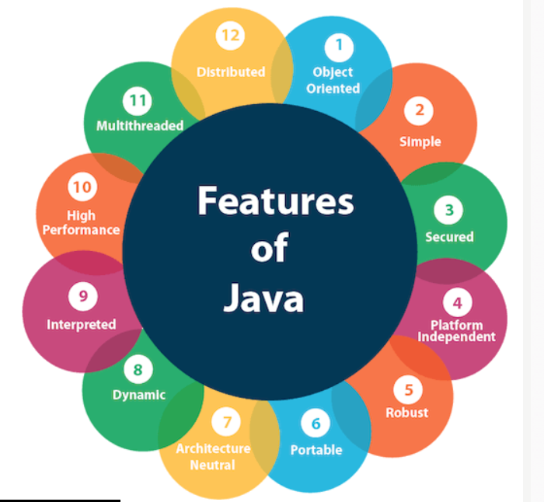
Features of Java
The primary objective of Java programming language creation was to make it portable, simple and secure programming language.
Apart from this, there are also some excellent features which play an important role in the popularity of this language.
The features of Java are also known as Java buzzwords.

Slide 9
A list of the most important features of the Java language is given below.
Simple
Object-Oriented
Portable
Platform independent
Secured
Robust
Architecture neutral
Interpreted
High Performance
Multithreaded
Distributed
Dynamic

Slide 10
JVM (Java Virtual Machine)
What is JVM
A specification where working of Java Virtual Machine is specified. But implementation provider is independent to choose the algorithm.
Its implementation has been provided by Oracle and other companies.
An implementation Its implementation is known as JRE (Java Runtime Environment).
Runtime Instance Whenever you write java command on the command prompt to run the java class, an instance of JVM is created.

Slide 11
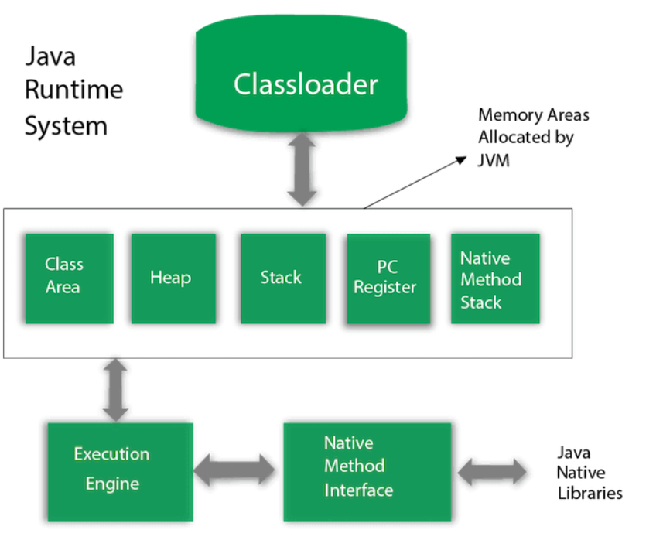
JVM Architecture

Slide 12
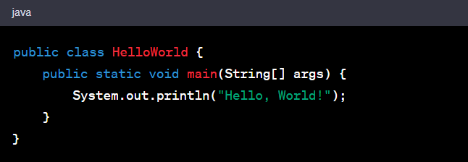
Certainly! The "Hello, World!" program is a traditional first program for beginners learning a new programming language. In Java, it looks like this:

Slide 13
Here's a breakdown of the code:
public class HelloWorld: This declares a class named HelloWorld. In Java, every application begins with a class definition.
public static void main(String[] args): This is the main method. It is the entry point of any Java program. The program starts executing from the main method.
System.out.println("Hello, World!");: This line prints the text "Hello, World!" to the console. The System.out.println method is commonly used to output data in Java.

Slide 14
THANK YOU

